Slide 1
Rethinking Scientific Presentations: The Assertion-Evidence Approach
Michael Alley
College of Engineering
Penn State
Notes:
Reference pages in The Craft of Scientific Presentations, 2nd ed.:
pp. 105-106, 132-135
Additional Notes: This presentation is designed to help instructors of university and high school students teach the assertion-evidence approach to presentations. These slides use the term “scientific presentations” to encompass the presentations done by engineers and scientists. If you prefer the more general term “technical,” you can use the Replace command to replace “scientific” with “technical” throughout. Likewise, if you desire a term more specific than “scientific,” you can use the same command to insert your preferred term (“engineering” or “biological” would be two examples).
References:
Michael Alley, The Craft of Scientific Presentations, 2nd ed. (New York: Springer-Verlag, 2013). Generally, the lowest price is on Amazon.com.
“Assertion-Evidence Approach,” http://www.assertion-evidence.com, ed. by Michael Alley (University Park: Penn State, 2016).

Slide 2
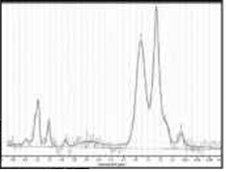
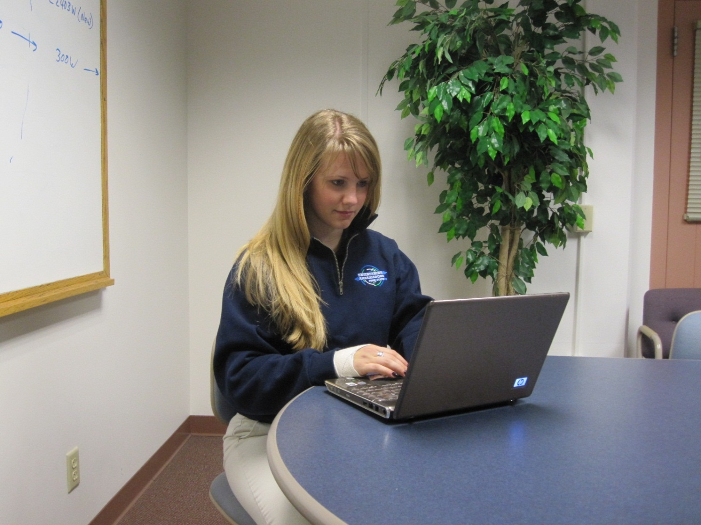
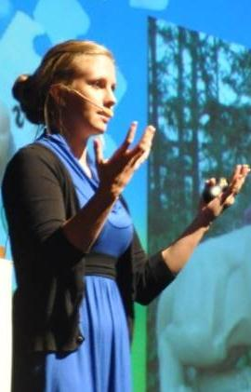

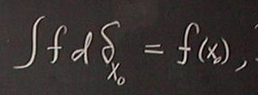
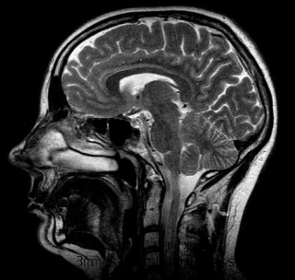
Slides influence the preparation, delivery, and understanding of a scientific presentation
[Alley, 2013]
Notes:
2
Reference pages in The Craft of Scientific Presentations, 2nd ed.:
pp. 117-122
References:
Michael Alley, The Craft of Scientific Presentations, 2nd ed. (New York: Springer-Verlag, 2013), pp. 117-122.

Slide 3
PowerPoint’s defaults arose before much research on slides and have not changed significantly
2003
1987
2007
[Gomes 2007]
[Alley, 2013]
Notes:
3
Reference pages in The Craft of Scientific Presentations, 2nd ed.:
p. 108
References:
Michael Alley, The Craft of Scientific Presentations, 2nd ed. (New York: Springer-Verlag, 2013), p. 108.

Slide 4
PowerPoint’s defaults run counter to how people learn
Does not filter noise
Leads to too many words
Consumes valuable space
[Garner et al., 2009]
Notes:
4
Reference pages in The Craft of Scientific Presentations, 2nd ed.:
pp. 108-114
References:
Michael Alley, The Craft of Scientific Presentations, 2nd ed. (New York: Springer-Verlag, 2013), pp. 108-114.

Slide 5
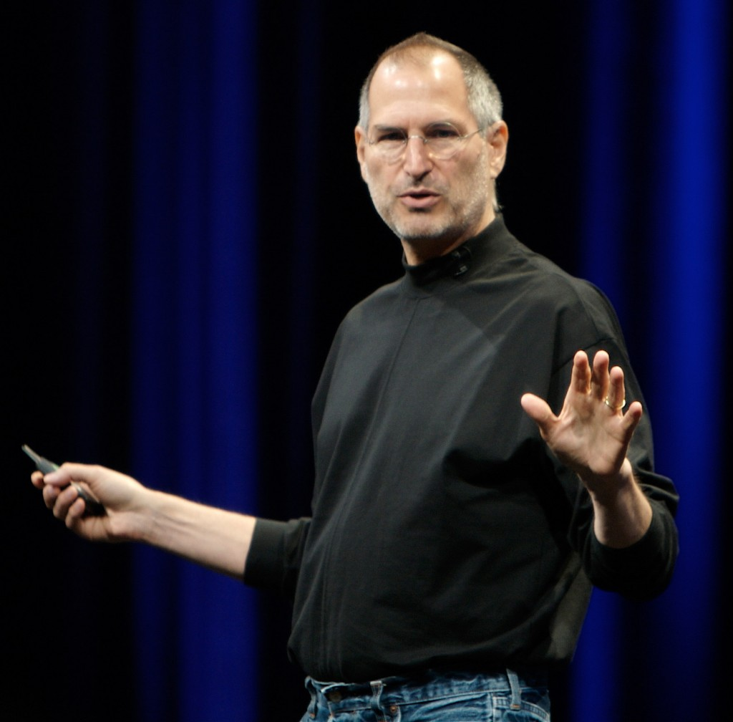
A key assumption is that slides are needed for that part of the presentation
[estevejobs.com]
[Alley, 2013]
Notes:
5
Reference pages in The Craft of Scientific Presentations, 2nd ed.:
pp. 106-107
References:
Michael Alley, The Craft of Scientific Presentations, 2nd ed. (New York: Springer-Verlag, 2013), pp. 106-107.

Slide 6
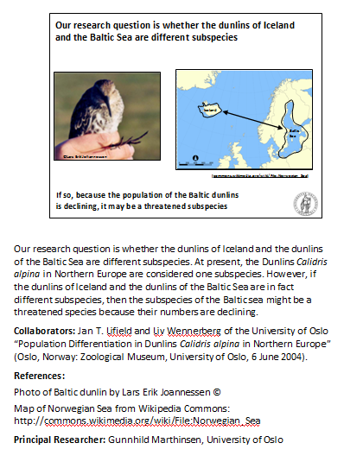



Another assumption is that the slides we project should differ from our handout
≠
[Alley, 2013]
Notes:
6
Reference pages in The Craft of Scientific Presentations, 2nd ed.:
p. 107
Additional Notes: The animation shows the difference between a slide designed for the projection and a crafted notes page, which we recommend to serve as a handout
References:
Michael Alley, The Craft of Scientific Presentations, 2nd ed. (New York: Springer-Verlag, 2013), p. 107.
Mimi Overbaugh, Handout for “Osseointegration for Lower-Limb Prosthetics,” http://writing.engr.psu.edu/models.html (University Park: Penn State, 2013).

Slide 7
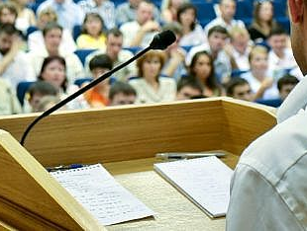
Another assumption is that the slides that we project are for our audience, rather than for us
≠
Notes:
7
Reference pages in The Craft of Scientific Presentations, 2nd ed.:
p. 107
References:
Michael Alley, The Craft of Scientific Presentations, 2nd ed. (New York: Springer-Verlag, 2013), p. 107.

Slide 8
The assertion–evidence structure consists of a message headline supported by visual evidence
[Settles, 2002]
[Alley, 2013]
Notes:
8
Reference pages in The Craft of Scientific Presentations, 2nd ed.:
pp. 129-135
References:
Michael Alley, The Craft of Scientific Presentations, 2nd ed. (New York: Springer-Verlag, 2013), pp. 130, 144.
Gary S. Settles, D.A. Kester, and Lori J. Dodson-Dreibelbis, “The External Aerodynamics of Canine Olfaction,” Sensors and Sensing in Biology and Engineering. ed. by F.G. Barth, J. A. C. Humphry, & T. W. Secomb (New York: Springer, 2002).

Slide 9
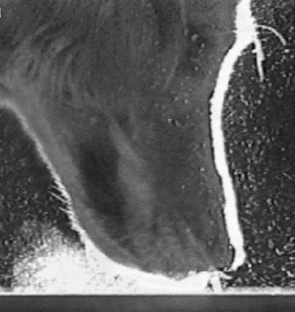
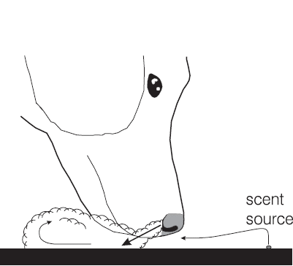
The way a dog sniffs does not contaminate the vapor stream from the scent source
scent
source
[Settles et al., 2002]
Notes:
Reference pages in The Craft of Scientific Presentations, 2nd ed.:
pp. 132-139
References:
Michael Alley, The Craft of Scientific Presentations, 2nd ed. (New York: Springer-Verlag, 2013), pp. 132-139.
Gary S. Settles, D.A. Kester, and Lori J. Dodson-Dreibelbis, “The External Aerodynamics of Canine Olfaction,” Sensors and Sensing in Biology and Engineering. ed. by F.G. Barth, J. A. C. Humphry, & T. W. Secomb (New York: Springer, 2002).

Slide 10
The way a dog sniffs does not contaminate the vapor stream from the scent source
scent
source
[Settles et al., 2002]
Notes:
Reference pages in The Craft of Scientific Presentations, 2nd ed.:
p. 140
References:
Michael Alley, The Craft of Scientific Presentations, 2nd ed. (New York: Springer-Verlag, 2013), p. 140.
Gary S. Settles, D.A. Kester, and Lori J. Dodson-Dreibelbis, “The External Aerodynamics of Canine Olfaction,” Sensors and Sensing in Biology and Engineering. ed. by F.G. Barth, J. A. C. Humphry, & T. W. Secomb (New York: Springer, 2002).

Slide 11
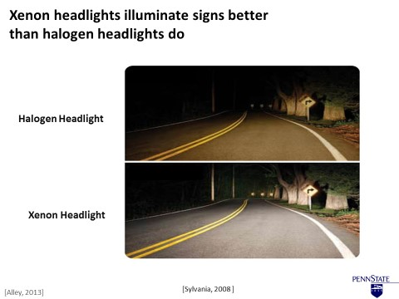
The first step is to write a sentence headline that states the main message of the slide
sentence
headline
Notes:
11
Reference pages in The Craft of Scientific Presentations, 2nd ed.:
pp. 130-139
References:
Michael Alley, The Craft of Scientific Presentations, 2nd ed. (New York: Springer-Verlag, 2013), pp. 130-139.
Scott Fishbone, “Comparison of Xenon Headlights Versus Halogen Headlights,” presentation (University Park: College of Engineering, April 2008).

Slide 12

A succession of electron acceptors occurs when an aquifer becomes contaminated with oil
Oil
–
–
–
Flow
NO₃
Mn
Fe
³⁺
⁻
CH₄
SO₄
²⁻
O₂
⁴⁺
[Alley, 2013]
Notes:
Reference pages in The Craft of Scientific Presentations, 2nd ed.:
pp. 122-123
Additional Notes: This example slide demonstrates the power of a sentence-assertion headline to focus the presenter. As a petroleum hydrocarbon plume migrates in an aerobic aquifer, the oxygen is quickly consumed because 10 mg of oxygen can degrade only three mg of benzene and more than 3 mg is constantly entering the aquifer. Once oxygen is consumed, anaerobic degradation begins with nitrate and manganese reduction, followed by iron reduction, sulfate reduction, and finally methanogenesis. Note that the plume has a nice smooth shape corresponding to the solution to the solute transport equation. Part of the goal of our study was to see how this theoretical shape compares to reality.
References:
Michael Alley, The Craft of Scientific Presentations, 2nd ed. (New York: Springer-Verlag, 2013), pp. 130-139.
Barbara Bekins, “The Influence of Hydrogeology on 25 Years of Natural Attentuation at a Crude Oil Spill Site,” 2004 Birdsall-Dreiss Lecture, mms://video.wr.usgs.gov/wrd/20may2004.wmv (Menlo Park: USGS, 2004).

Slide 13


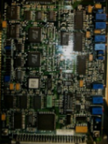
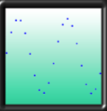
A data acquisition system changes the form of the data
A digital acquisition system has to sample at a rate fast enough to retain the shape of the analog signal
Measurement Device
Analog-to-Digital
Converter
[Alley, 2013]
Notes:
Reference pages in The Craft of Scientific Presentations, 2nd ed.:
pp. 110-111
References:
Michael Alley, The Craft of Scientific Presentations, 2nd ed. (New York: Springer-Verlag, 2013), pp. 110-111.

Slide 14
A digital acquisition system has to sample at a rate fast enough to retain the shape of the analog signal
Measurement Device
Analog-to-Digital
Converter
Notes:
Reference pages in The Craft of Scientific Presentations, 2nd ed.:
pp. 115-116
References:
Michael Alley, The Craft of Scientific Presentations, 2nd ed. (New York: Springer-Verlag, 2013), pp. 110-111.
H.H. Robertshaw, “Class Period 15: Signals and Systems,” class lecture in ME 4005 (Blacksburg, VA: Virginia Tech, 16 March 2004).

Slide 15
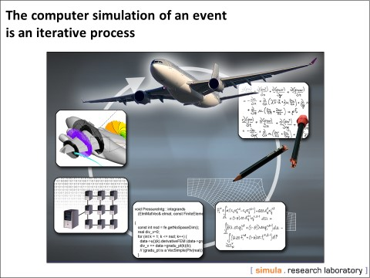
The second step is to find or create visual evidence that supports the sentence headline
visual evidence
[Alley, 2013]
Notes:
15
Reference pages in The Craft of Scientific Presentations, 2nd ed.:
pp. 140-143
References:
Michael Alley, The Craft of Scientific Presentations, 2nd ed. (New York: Springer-Verlag, 2013), pp. 140-143.
Are Magnus Bruaset and Jan Olav Langseth, “Computational Simulations at Simula,” presentation (Oslo: Simula Research Laboratory, 2005).

Slide 16
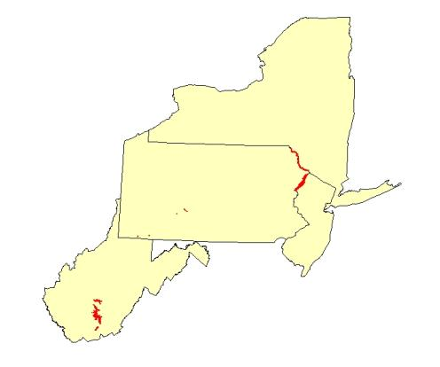
Most streams were classified in fair condition
because of high chloride concentrations
West Virginia Parks:
48% Fair
Sulfate caused most problem
Delaware River Parks:
79% Fair
Chloride caused most problems
Western Pennsylvania Parks:
75% Fair
Chloride caused most problems
Notes:
Reference pages in The Craft of Scientific Presentations, 2nd ed.:
pp. 148-149
References:
Michael Alley, The Craft of Scientific Presentations, 2nd ed. (New York: Springer-Verlag, 2013), pp. 148-149.
Jimmy Webber, “Water Quality of Streams in National Parks of the Mid-Atlantic USA: A Chemical and Biological Assessment,” Ph.D. dissertation defense (University Park: Penn State School of Forestry, 31 March 2012).

Slide 17
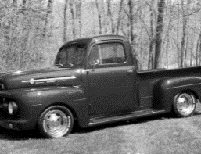
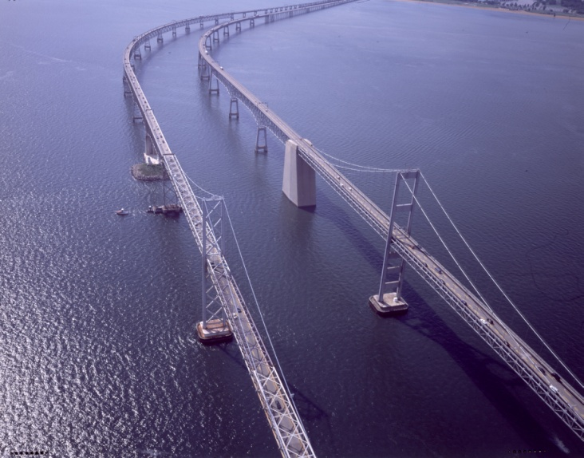
Since its construction in 1952, traffic across the bridge has grown exponentially
1952
1.1 million vehicles
[Maryland Transportation Authority, 2007]
Notes:
Reference pages in The Craft of Scientific Presentations, 2nd ed.:
pp. 140-142
References:
Michael Alley, The Craft of Scientific Presentations, 2nd ed. (New York: Springer-Verlag, 2013), pp. 140-142.
Adapted from Brittany Pavelko
17

Slide 18
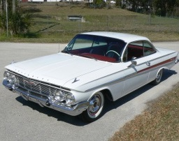
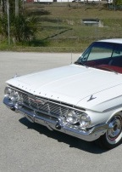
Since its construction in 1952, traffic across the bridge has grown exponentially
1952
1.1 million
1961
1.5 million
[Maryland Transportation Authority, 2007]
Notes:
Reference pages in The Craft of Scientific Presentations, 2nd ed.:
pp. 140-142
References:
Michael Alley, The Craft of Scientific Presentations, 2nd ed. (New York: Springer-Verlag, 2013), pp. 140-142.
Adapted from Brittany Pavelko
18

Slide 19
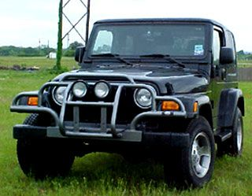

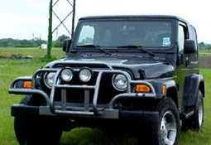
Since its construction in 1952, traffic across the bridge has grown exponentially
1952
1.1 million
1961
1.5 million
2007
27 Million
[Maryland Transportation Authority, 2007]
Notes:
Reference pages in The Craft of Scientific Presentations, 2nd ed.:
pp. 140-142
References:
Michael Alley, The Craft of Scientific Presentations, 2nd ed. (New York: Springer-Verlag, 2013), pp. 140-142.
Adapted from Brittany Pavelko
19

Slide 20
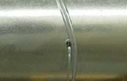
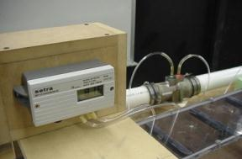
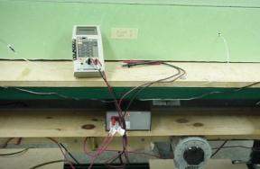
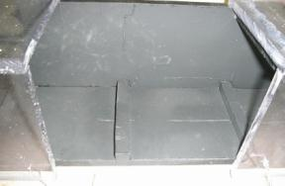

Normalized friction factors and Nusselt numbers correlated our data with the data of others
Pressure Taps
Venturi Meter
Voltmeter
Thermocouples
Pressure Drop
Reynolds Number
Heat Flux, q˝
T_{inlet}
T_{wall}
T_{bulk}
h
Friction Factor, f
Nu_{o}, f_{o}
Nu
Notes:
20
Reference pages in The Craft of Scientific Presentations, 2nd ed.:
pp. 146-148
References:
Michael Alley, The Craft of Scientific Presentations, 2nd ed. (New York: Springer-Verlag, 2013), pp. 140-142.
Cook, Jason, John Hurley, Ryan McNulty, Zack Reuter, and Charles Smith, “Recommendation of Rib Configuration for the Internal Cooling of Gas Turbine Blades” (Blacksburg, VA: Mechanical Engineering 4006, Fall 2004).

Slide 21
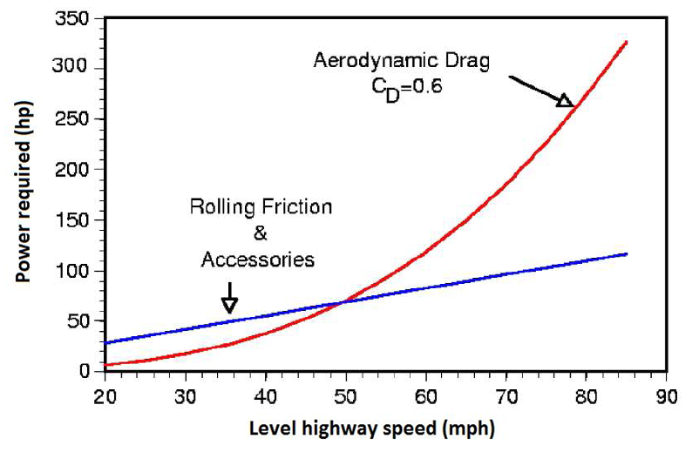

At typical highway speeds, overcoming drag requires about two-thirds of a truck engine’s output
Aerodynamic Drag
C_{D} = 0.6
Rolling Friction and Accessories
[McCallen, 2004]
Notes:
Reference pages in The Craft of Scientific Presentations, 2nd ed.:
pp. 143-144
References:
Michael Alley, The Craft of Scientific Presentations, 2nd ed. (New York: Springer-Verlag, 2013), pp. 140-142.
Cook, Jason, John Hurley, Ryan McNulty, Zack Reuter, and Charles Smith, “Recommendation of Rib Configuration for the Internal Cooling of Gas Turbine Blades” (Blacksburg, VA: Mechanical Engineering 4006, Fall 2004).
2010 by Casey Howsare, an engineering science student at Penn State. (CSP, 143-144)

Slide 22
The third step in creating assertion-evidence slides is to change the defaults of PowerPoint
Notes:
22
Reference pages in The Craft of Scientific Presentations, 2nd ed.:
pp. 154-159
References:
Michael Alley, The Craft of Scientific Presentations, 2nd ed. (New York: Springer-Verlag, 2013), pp. 154-159.

Slide 23
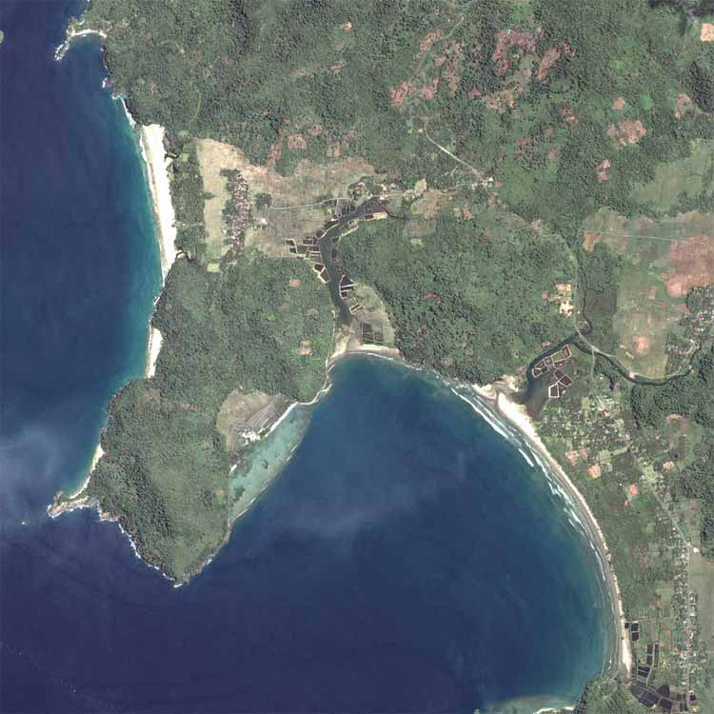
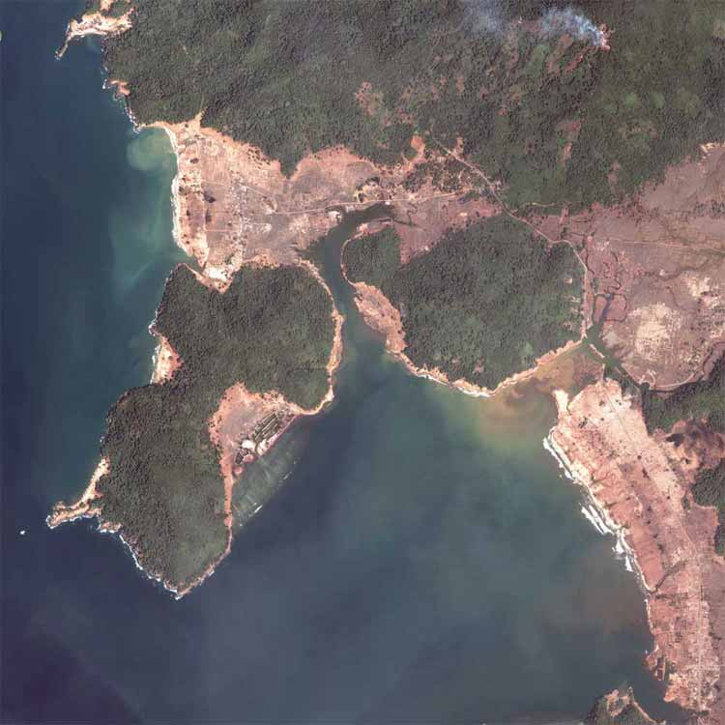
Tsunamis cause devastating destruction, especially to sparsely vegetated areas.
2004 Indian Ocean Tsunami: Gleebruk Village, Sri Lanka
Before:
After:
PPT’s defaults crowd this slide
http://homepage.mac.com/demark/tsunami/14.html
Notes:
23
Reference pages in The Craft of Scientific Presentations, 2nd ed.:
pp. 166-168
References:
Michael Alley, The Craft of Scientific Presentations, 2nd ed. (New York: Springer-Verlag, 2013), pp. 166-168.

Slide 24
Tsunamis cause devastating destruction, especially to sparsely vegetated areas
Before
After
Sparse
Sparse
Sparse
2004 Indian Ocean Tsunami: Gleebruk Village, Sri Lanka
[homepage.mac.com/demark/]
Notes:
24
Reference pages in The Craft of Scientific Presentations, 2nd ed.:
pp. 166-168
References:
Michael Alley, The Craft of Scientific Presentations, 2nd ed. (New York: Springer-Verlag, 2013), pp. 166-168.

Slide 25
A common error in the beginning of scientific talks is to leave the audience behind
[Alley, 2013]
Notes:
25
Reference pages in The Craft of Scientific Presentations, 2nd ed.:
p. 72
References:
Michael Alley, The Craft of Scientific Presentations, 2nd ed. (New York: Springer-Verlag, 2013), p. 72.

Slide 26
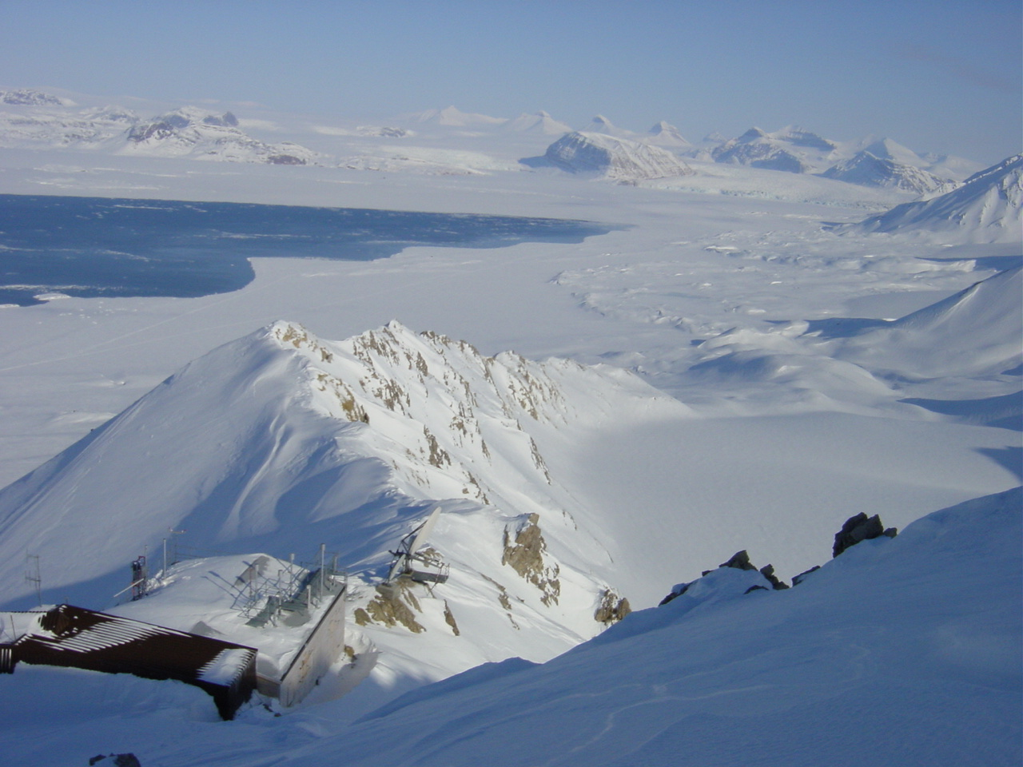


Determining Whether Atmospheric Mercury Goes into Surface Snow after a Depletion Event
Ny-Ålesund
Katrine Aspmo
Torunn Berg
Norwegian Institute for Air Research
Grethe Wibetoe
University of Oslo, Dept. of Chemistry
June 16, 2004
Event
[Alley, 2013]
Notes:
26
Reference pages in The Craft of Scientific Presentations, 2nd ed.:
pp. 72-73
References:
Michael Alley, The Craft of Scientific Presentations, 2nd ed. (New York: Springer-Verlag, 2013), pp. 72-73
Adapted from K. Aspmo, T. Berg, and G. Wibetow, “Atmospheric Mercury Depletion Events in Polar Regions during Arctic Spring, “ presentation (Oslo: University of Oslo, 16 June 2004).
2.

Slide 27
A common error in the mapping of scientific talks is to show a list that is not memorable
[Alley, 2013]
Notes:
27
Reference pages in The Craft of Scientific Presentations, 2nd ed.:
pp. 176-178
References:
Michael Alley, The Craft of Scientific Presentations, 2nd ed. (New York: Springer-Verlag, 2013), pp. 176-178.

Slide 28
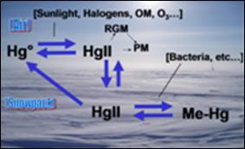
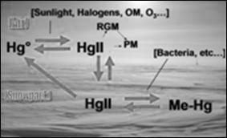
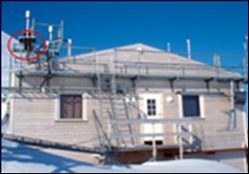
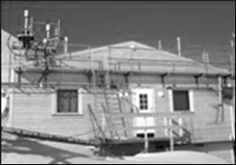
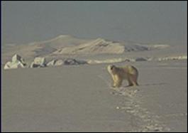
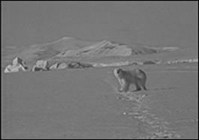
This talk traces what happens to mercury after it depletes from the atmosphere in arctic regions
Theory for mercury cycling
Measurements from Station
Environmental implications
Notes:
Reference pages in The Craft of Scientific Presentations, 2nd ed.:
pp. 178-180
Additional Notes: Be sure to view this slide in the slideshow mode to see how the presenter keeps the audience focused on the appropriate image. This technique of moving from black-and-white images to color to keep the audience on track originated with students at Penn State (see cheetah presentation).
References:
Michael Alley, The Craft of Scientific Presentations, 2nd ed. (New York: Springer-Verlag, 2013), pp. 178-180.
Adapted from K. Aspmo, T. Berg, and G. Wibetow, “Atmospheric Mercury Depletion Events in Polar Regions during Arctic Spring, “ presentation (Oslo: University of Oslo, 16 June 2004).

Slide 29
A common error in the endings of scientific talks is to waste the last slide
[Alley, 2013]
Notes:
29
Reference pages in The Craft of Scientific Presentations, 2nd ed.:
pp. 181-184
References:
Michael Alley, The Craft of Scientific Presentations, 2nd ed. (New York: Springer-Verlag, 2013), pp. 181-184.

Slide 30

In summary, high concentrations of acetic acid help protect steel from corrosion
Adsorbed HOAc allows the growth of siderite
A thick siderite layer protects the steel from corrosion
FeCO₃
Steel
Fe_{3+x} O_{4-y}
Questions?
Notes:
30
Reference pages in The Craft of Scientific Presentations, 2nd ed.:
pp. 181-184
References:
Michael Alley, The Craft of Scientific Presentations, 2nd ed. (New York: Springer-Verlag, 2013), pp. 181-184.
Omar Rosas Camacho, “High concentrations help protect steel from corrosion,” master’s defense presentation (University Park: Material Science and Engineering, Penn State, 2010).

Slide 31


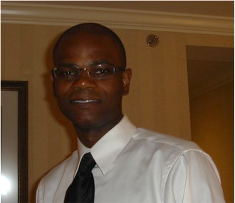


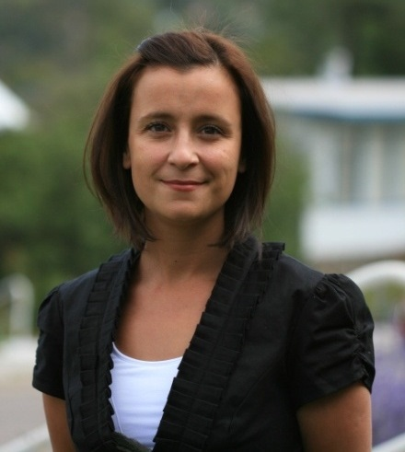


Many engineers and scientists have had success using the assertion-evidence approach
writing.engr.psu.edu/speaking.html
Notes:
31
Reference pages in The Craft of Scientific Presentations, 2nd ed.:
p. 199
Additional Notes: Appeal to engineers and scientists to be an experimentalist and to try the assertion-evidence approach in an upcoming presentation. The engineers and scientists should give the approach a fair shake—beginning with the template and using the example slides as models.
References:
Michael Alley, The Craft of Scientific Presentations, 2nd ed. (Springer-Verlag, 2013). Generally, the lowest price is on Amazon.com.
Michael Alley, “Scientific Presentations: The Assertion-Evidence Approach,” http://writing.engr.psu.edu/speaking.html (University Park: Penn State, 2013).

